Slide 1
table Entity columns id, level, name, iso_code
table
Meta_indicator_data columns id, p_name, family, num_type, provider, P_description
level may be Country, State, Province, etc.
name is the official name from the data provider
iso_code is a country’s iso code (for other entities, this will be null for now)
P_name is the name of the indiator taken straight from the data provider
family is a macro category used to retrieve data based on subject matter
Num-type represents decimal, percentage, interger, etc. Provider is the full name of the data provider p_description description of this indicator from the provider
table Literal_indicator_data
columns id, ent_id, year, value, dispay_name, meta_id,
year is the year the data point was observed
value is the raw value stored as a string
display_name is a composite string of indicator name and source name (both may be shortened for easy display).
All id's are simple primary key ids that may also serve also as foreign keys
Strengths – a simple to understand db minimizing redundancy. Weaknesses – parsing from APIs will require serious coding, dealing with Meta_indicator_data will be trial and error.

Slide 2
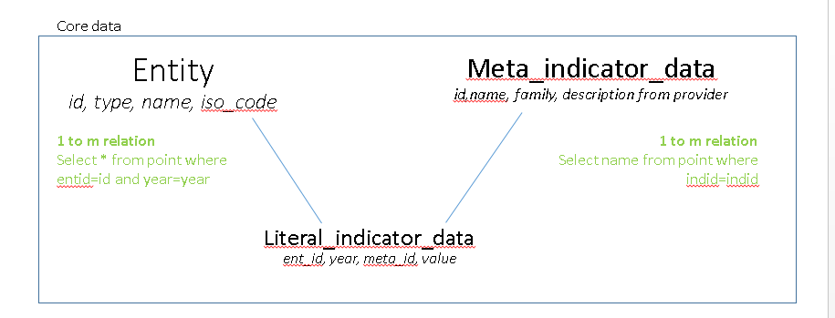
Saved_data_sets ID, date created, comments, tags

